Slide 1
Race, Ethnicity, and Measurement Error
Bruce D. Meyer, University of Chicago, NBER, and AEI Nikolas Mittag, CERGE-EI
Derek Wu, University of Virginia
Conference on Research in Income and Wealth
Pre-Conference, July 19, 2023
Disclaimer: Any views expressed are those of the authors and not those of the U.S. Census Bureau. The Census Bureau’s Disclosure Review Board and Disclosure Avoidance Officers have reviewed this information product for unauthorized disclosure of confidential information and have approved the disclosure avoidance practices applied to this release, authorization numbers CBDRB-FY21-CES014-038 and CBDRB-FY23-041.
Notes:
This is joint work with Nikolas Mittag and Derek Wu. All views are our own, and results have been approved for disclosure by the Census Bureau

Slide 2
Many Literatures Depend on Program Receipt Differences by Race and Ethnicity
Large literatures depend on accurate survey data on receipt of social insurance and welfare programs by race and ethnicity
Research using survey data has found important differences by race and ethnicity in program receipt
One group of these papers emphasizes lower receipt of transfers by Black or Hispanic individuals, suggesting that state laws or their administration has led to disparate access to these programs (Gould-Werth and Shaefer 2012; Kuka and Stuart 2021; Forsythe and Yang 2021; U.S. GAO 2022)
A second group of papers examines whether Black or Hispanic individuals are overrepresented among program recipients, focusing mostly on means-tested transfers (Moffitt and Gottschalk 2001)
Other papers have emphasized racial and ethnic differences in measures of poverty and material well-being (Burkhauser et al. 2022; U.S. Census Bureau 2022).
Notes:
Moffitt and Gottschalk conclude that higher program receipt can mostly be explained by income and employment patterns.

Slide 3
Reports of Program Receipt are Notoriously Inaccurate
A large literature shows that weighted survey reports understate administrative aggregates for counts of recipients and dollars (Meyer, Mok, and Sullivan 2015; Rothbaum 2015)
Another literature shows that linked survey and administrative microdata show substantial misreporting, most commonly underreporting (e.g., Marquis and Moore 1990; Hyunh et al. 2002, Meyer and Mittag 2019, 2021)
Both literatures tend to find that the problem has become worse over time (Gathright and Crabb 2014; Meyer, Mok, and Sullivan 2015)
While overall error rates are known to be high, distributional analyses along characteristics such as race/ethnicity could still be unbiased if the errors are constant
Unlikely to be true given non-classical nature of survey measurement error in program receipt (e.g. Bollinger and David, 1997; Meyer, Mittag, and Goerge 2022)
Notes:
We should be able to pull a lot of references to both the aggregates and linked papers from
Meyer, Mok and Sullivan JEP 2015, Meyer and Mittag Journal of Econometrics 2021, AEJ Applied 2019
** DW: this will probably become two slides

Slide 4
Addressing the Problem of Survey Error
For problems of endogeneity, suspecting that there may be bias often based on conjectures about unobserved variables typically prompts researchers to reject OLS and apply IV methods that may or may not improve the bias
For measurement problems, we have evidence that there is bias and often know methods to improve estimates, yet we currently do not have the same expectation that we should change methods
On the positive side, some recent papers recognize the problem of high error rates (e.g. Kuka and Stuart, 2021)
Yet, despite mounting evidence, the problem that errors are related to covariates is usually put aside
The goal of this paper is to provide evidence that differences in reporting between racial and ethnic groups lead to bias in estimates of differences between these groups so we should change our expectations about appropriate methods
Notes:
I tried to put together a version of Bruce’s argument regarding the different approaches to measurement error and endogeneity. I tried to make it fit in this context and make it possible to briefly make this point without diving into detail. Yet I don’t know whether it belongs in this presentation and whether this is the best way to make it. Feel free to cut the slide or change it in any way. I just thought it would be worth fleshing out the argument somewhere, I’m sure we’ll want to make it in some form somewhere at some point.

Slide 5
What this Paper Does
Surveys the literature on misreporting; very few papers examine misreporting by race and ethnicity
Difficult to do with aggregates as they are rarely reported by race and ethnicity or definitions may not be comparable in administrative and survey sources
Linked data studies often rely on small samples which make disaggregation unlikely and precision low
Differences by race and ethnicity have become of greater interest recently
Highlights the results of three linked dataset studies, with increasing focus on race and ethnicity
Discusses implications and provides suggestions for future use of race and ethnicity data

Slide 6
Surveying the Literature on Racial and Ethnic Differences in Reporting
Our review today focuses on programs and income sources we have examined in our work as a convenient starting point
Other research has used linked data to examine Medicaid, pensions, SSI, OASDI, etc. (preliminary summaries below)
We will continue to screen the literature for work on further programs and income components
That being said, the vast majority of studies analyzing the misreporting of program receipt do not examine differences in reporting by race and ethnicity
Surprisingly to us, even those that report differences in error rates and/or implications or errors by race and ethnicity generally ignore these differences when describing and discussing their results
Notes:
**N: Moved this slide after slide above, but not sure about ideal content and place. It probably still needs some work. We could include more detail and/or add references. May also need a more serious title (e.g. “What we plan to add to this paper”, “Plans” “Work in Progress”). I like the last two bullet points, but am not sure we can find good and clean statistics on them. Simply because many of the studies mention or include race without really discussing it. So including them as “no” may yield complaints, while including them as “yes” overstates what they do. We could replace them by a bullet point that says that we will summarize the exceptions we have found below.
Medicaid receipt papers Davern and co-authors
Old Food Stamps papers by Bollinger and David
SSI and OASDI misreporting papers by Rupp, Huynh, Nicholas, Wiseman and others

Slide 7
Misreporting of Survey SNAP and TANF+GA

Slide 8
Misreporting of SNAP in Illinois and Maryland: Data and Methods
Meyer, Mittag, and Goerge (2022, Journal of Human Resources)
Surveys analyzed: 2001 ACS, 2002-2005 CPS, and 2001 and 2004 SIPP panels (covering data from Jan 2001-Apr 2005)
Links surveys to administrative food stamp records in Illinois and Maryland by PIK (essentially anonymized SSNs). Household-level PIK rates are:
Admin data: 96% in IL and 98% in MD
ACS: 93% in IL and 95% in MD
CPS: 68% in IL and 81% in MD
SIPP: 71% for both states
Unit of analysis is household (age 16+) with at least one PIKed member
Adjust survey weights for incomplete PIKing using inverse probability weighting at household level
Reference periods and program definitions match between admin data and survey data
ACS is past 12 months, CPS is previous calendar year, and SIPP is four-month period
Admin records are at monthly basis so can be easily adjusted to match survey periods
Notes:
** DW: filled in details here

Slide 9
Determinants of False Negatives and Positives in IL and MD: Non-White vs. White
Notes:
Need to note always reporting average partial effects, should add baseline rates to tables.
Non-white relative to white (the paper reports reverse but for this paper we might want to just change the sign and describe as Non-white relative to white)
White rows from Table 3 and 4 in one small table
** DW: Multiplied “white” coefficients by negative one and re-labeled as “non-white”

Slide 10
Determinants of Reported and Admin SNAP Receipt in IL and MD: Non-White vs. White
Notes:
Non-white relative to white (the paper reports reverse but for this paper we might want to just change the sign and describe as Non-white relative to white)
**Report where survey and admin statistically different.
White rows from Table 5 a second small table?
** DW: Multiplied “white” coefficients by negative one and re-labeled as “non-white”

Slide 11
Misreporting of SNAP in Illinois and Maryland: Results
Higher rates of false negatives for non-whites, always negative and of substantial magnitude, significant in ACS and SIPP but not CPS
Also higher rates of false positives for non-whites in 3 of 5 samples, significantly higher in the ACS in Illinois and the SIPP sample which combines the two states
Looking at sample of those with income less than twice the poverty line, survey reports indicate that non-whites have lower receipt of SNAP than administrative data indicate (differences significant in 4 of 5 samples)
Did not set out to examine racial differences in misreporting, but rather race was one of 25 explanatory variables in paper
Notes:
**Update, could expand last bullet under Table 5

Slide 12
Misreporting of SNAP and TANF+GA in New York: Data and Methods
Celhay, Meyer, and Mittag (2023, Working Paper)
Surveys analyzed: 2008-2012 ACS, 2008-2013 CPS, and 2004 and 2008 SIPP Panels (covering Aug 2008-Dec 2012)
Link surveys to administrative SNAP and TANF+GA records in New York by PIK. Household-level PIK rates are:
93% in ACS, 91% in CPS, and 95% in SIPP
Unit of analysis is household with at least one PIKed member, and reference periods and program definitions match between admin data and survey data
Extends prior IL/MD results by looking at a different state (NY), additional programs (TANF + GA), more recent time period (2008-12), and separate non-white groupings (specifically black non-Hispanic and Hispanic)
Notes:
** DW: filled in details here

Slide 13
Determinants of False Negatives and Positives in NY: Black/Hispanic vs. White
Notes:
** Looks good, would like to align numbers on decimal point

Slide 14
Determinants of Reported and Admin SNAP and TANF+GA Receipt in NY: Black/Hispanic vs. White
Notes:
** Align on decimal point?
Report in slide where statistically different?
** DW: for SNAP/TANF, differences between survey and admin are all statistically significant at 1% level except for Hispanic in SIPP for SNAP (difference significant at 10% level)

Slide 15
Misreporting of SNAP and TANF+GA in New York: Results
Continues to find strong evidence of higher false positives and higher false negative rates for black non-Hispanic individuals (relative to white individuals)
Differences persist across all three surveys and both programs
Additionally analyzes Hispanic individuals, documenting the same pattern of higher false positive and false negative rates
For SNAP, differences similar across all three surveys
For TANF+GA, false negatives are higher, but false positives lower
Also finds higher receipt rates for both groups in survey than whites – but the differences are even larger when using administrative measures of receipt (always significantly so)
Taken together, strong patterns so far across three states (IL, MD, NY), two programs (SNAP and TANF/GA), and multiple time periods (spanning 2001-2012) that biases in survey reports are larger for non-white (particularly black and Hispanic) individuals
Notes:
**N: I split the first bullet point to make the addition of Hispanic more salient. But that comes at the expense of repetition.

Slide 16
Misreporting of SNAP and TANF+GA: Results from Other Papers
Several additional papers use linked data to examine misreporting of SNAP, its consequences, and potential solutions
To our knowledge, none of these papers discusses results by race
Yet some papers contain statistics by race that support the patterns of increased error rates and strong biases we document above:
False negatives are higher for Blacks: Fox, Heggeness, Pacas, Stevens, 2017
Bias in receipt rates appears larger for Blacks and Hispanics than for other groups: Fox, Heggeness, Pacas, Stevens, 2017; Fox, Shantz 2018
Error in average amounts reported by true recipients are small overall, but tend to be larger for minorities: Fox, Heggeness, Pacas, Stevens, 2017; Fox, Shantz 2018
Bias in measures of poverty larger for Blacks and Hispanics than for other groups: Fox, Heggeness, Pacas, Stevens 2017; Stevens, Fox, Heggeness 2018; Rothbaum, Fox, Shantz 2021 (Hispanic only)
Notes:
**N: Added this slide. I only summarized the SNAP results, but Fox and Shanz 2018 also look at TANF. We also have quite a few papers on SNAP that don’t look at race at all (Bollinger and David, etc.), but I only mention the ones that contain at least some information on race. Let me know if I should add that or anything else.

Slide 17
Poverty Reduction When Correcting SNAP (Stevens, Fox, and Heggeness 2018)
Source: Calculated from numbers in Table 5 of Stevens, Fox, Heggeness 2018, which are based on CPS ASEC linked to state SNAP administrative records from Illinois, Maryland, Oregon, and Virginia for calendar years 2009-2015. Percent of Survey may be slightly affected by rounding in the table.
Notes:
Skip White, not Hispanic? Only percent of Survey Poverty? I tried to align the design with the figure on poverty, but lacked some chart-making skill that I’d be happy to learn.

Slide 18
Misreporting of Survey UI

Slide 19
Background on Unemployment Insurance Receipt
Unemployment Insurance (UI) is a key component of the safety net
Countercyclical nature of the program makes it particularly important during economic downturns
During 2020, a record $581 billion of UI was paid out under pandemic-induced program expansions
Recent studies have sought to document disparities in UI receipt across subgroups
Gould-Werth & Shaefer (2012), Nichols & Simms (2012), Bitler, Hoynes, & Schanzenbach (2021), Forsythe & Yang (2021), Kuka & Stuart (2021), Skandalis, Marinescu, & Massenkoff (2022)
Notes:
UI is a key component of the safety net. In 2020 we spent over half a trillion dollars on UI.
Numerous studies rely on accurate reporting of unemployment insurance. These studies examine the role of the safety net in shielding income drops, or preventing poverty, for example. Others look at the role of transfers in altering the income distribution or labor supply. Many recent papers have examined access to UI by studying takeup and how it differs across education, income, gender, race or ethnicity.

Slide 20
Misreporting of UI: Data and Methods
Meyer, Wu, Stadnicki, and Langetieg (2023, Working Paper)
We obtain administrative UI receipt information from Form 1099-G
Use IRS Form W-2 to help calculate UI eligibility
Link admin records to 2010 data from two Census surveys (2011 CPS ASEC and 2008 SIPP Panel)
Both surveys ask respondents about UI receipt and amounts
Default reference period for CPS is calendar year; we combine information across multiple waves of the SIPP to construct calendar year receipt
Both surveys ask about unemployment, allowing comparison to admin data
Link records using Protected Identification Keys (PIKs) at individual level
CPS sample consists of individuals who have PIKs and are not whole imputed; SIPP sample consist of individuals who have PIKs
Re-weight to account for non-random missing PIKs (& whole imputes in CPS); Just under 90 percent of individuals PIKed
Focus on reference year 2010, during the height of the Great Recession
Year with highest amount of benefits paid prior to pandemic
Time when UI benefits were particularly important
Notes:
The CPS is the source of all the key official statistics; also the most used survey of the labor market.
The SIPP is thought to provide the best measures of income and program receipt as it it specifically designed to do that. Our analyses over the past 15 years tend to bear out this reputation.
In SIPP do we have two samples to account for tradeoff between complete records with no attrition, and sample selection from using those who don’t attrit
Form 1099-G (information returns for individuals receiving government payments; UI is on Box 1)
Form 1040 (contains UI amounts for tax units; UI is on Line 19 in 2010) – only available for filers

Slide 21
False Positive and False Negative Misreporting Rates (%) by Race/Ethnicity, CPS and SIPP
Notes:
** DW: Previous version of table had other subgroups; kept just the race ones and moved the original full table to appendix
** DW: insert APEs a la Ny/IL/MD tables as separate slide

Slide 22
Determinants of False Negatives and Positives: Race/Ethnicity Groups vs. White

Slide 23
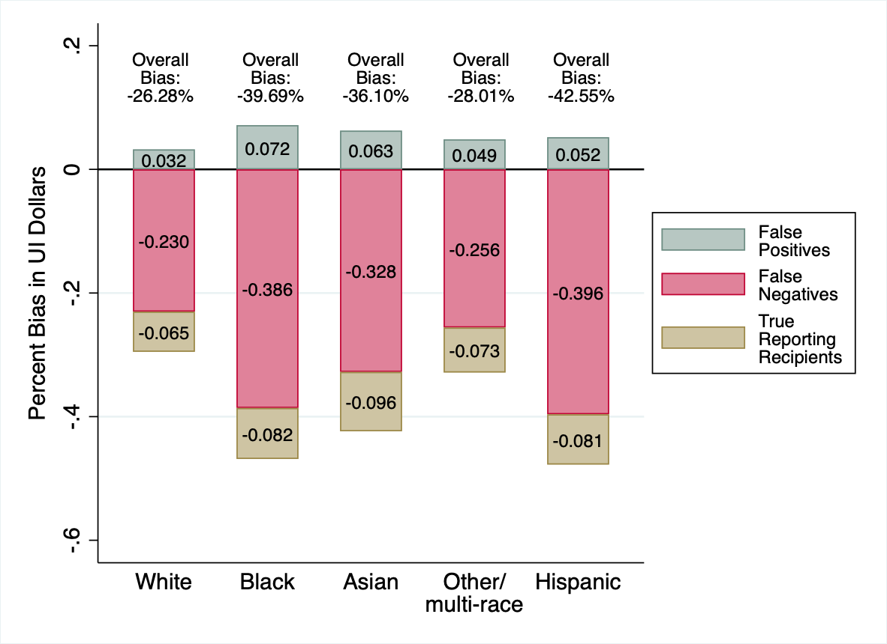
Decomposition of Bias in Reported Survey UI Benefits ($): By Race/Ethnicity in CPS
Source: 2011 CPS ASEC, IRS Forms 1040 (Tax Year 2010 and Calendar Year 2011 Filings), and 1099-G (Tax Year 2010)
All results were approved for release by the IRS SOI Disclosure Review Board and the U.S. Census Bureau, authorization number CBDRB-FY21-CES014-038 and CBDRB-FY23-041
Notes:
This figure and the next two show that most of the differences in dollar reporting by race, ethnicity, income and education in the CPS are due to the false negative reporting differences that I just went through.

Slide 24
Decomposition of Bias in Reported Survey UI Benefits ($): By Race/Ethnicity in SIPP
Source: 2011 CPS ASEC, IRS Forms 1040 (Tax Year 2010 and Calendar Year 2011 Filings), and 1099-G (Tax Year 2010)
All results were approved for release by the IRS SOI Disclosure Review Board and the U.S. Census Bureau, authorization number CBDRB-FY21-CES014-038 and CBDRB-FY23-041
Notes:
** DW: filled this in with the SIPP figure

Slide 25
Selected Coefficients in Probit Models of UI Receipt (CPS)
Notes:
**Hard to select the box rather than the larger box with the table

Slide 26
Selected Coefficients in Probit Models of UI Receipt (SIPP)

Slide 27
Misreporting of UI: Results
Survey-reported UI dollars are most understated among Black and Hispanic individuals
Differences across subgroups in overall misreporting are driven primarily by differences in false negative rates (i.e., under-reporting at the extensive margin)
Gaps in false negative rates between subgroups largely remain statistically significant after controlling for other individual characteristics
If we rely only on survey reports of UI, we find that the differences in take-up rates between Black and white individuals tend to be statistically insignificant, holding other factors constant
In contrast, using admin reports of UI leads to statistically significantly higher take-up rates for Blacks relative to whites, ceteris paribus
This pattern holds in samples of UI eligible defined in several different ways using survey and/or admin data
Similar patterns for Hispanics

Slide 28
Misreporting of Other Programs and Income Sources in Surveys
Notes:
**N: added “Programs and” to include Medicaid below

Slide 29
Misreporting of Medicaid and Medicare: Preliminary Overview
Some studies of Medicaid reporting and coverage linked surveys such as the CPS and ACS to administrative Medicaid data (e.g., MSIS data)
Similar to studies of SNAP above, most papers do not examine race or ethnicity, but some papers report statistics of interest
Our review so far is in line with the patterns above:
Both false positives and false negatives higher for Blacks and Hispanics (Noon et al. 2019), “any error” higher for minorities (Call et al. 2022)
Bias in estimated receipt larger for Blacks and Hispanics than for other groups (Davern et al. 2009)
Bhaskar et al. (2016) find higher false negative rates of minorities for Medicare
Notes:
**N: Added this slide. Am much less confident that I found everything, since I know less about the literature and the methods differ more. Let me know if we should emphasize that more. Minor note: “Black” is positive, but not significant in Noon et al., but I did not find an elegant way to make that clear.

Slide 30
Bias in Medicaid Receipt Rates (Davern, Klermann, and Ziegenfuss 2009)
Source: Calculated from numbers reported in Table 4 of Davern, Klermann, Ziegenfuss, 2009. Their estimates are based on CPS ASEC data for calendar years 2006-2007 where Medicaid receipt was imputed from error models estimated using CPS ASEC data linked to MSIS administrative data for calendar years 2000-2002. Percent of Survey may be slightly affected by rounding in the table.
Notes:
See slide/chart for SNAP. Just a preliminary version, happy to adjust it.

Slide 31
Misreporting of Social Security and Pension Income: Data and Methods
Olson (2001) finds Social Security amounts to be more severely misreported by Blacks and Hispanics in SIPP
Focus on more recent study by Bee and Mitchell (2017, Working Paper)
Link 2013 CPS ASEC to administrative SSA records on Social Security and retirement income from IRS Form 1099-R (among other admin sources) by PIK. Individual-level PIK rates are ~90% in CPS
Unit of analysis is PIKed elderly individual (aged 65+) and reference period is calendar year
In their main text, Bee and Mitchell do not explicitly discuss misreporting of income sources by race, but they disclose numbers in Table 6 (Panels A and B) that enable one to back out false positive and false negative rates by race/ethnicity
Notes:
Did Bee and Mitchell calculate poverty by race
** DW: filled in details here
** N: Found the Olson paper in Sophie’s summary and added a bullet point. Overall there is underreporting, but those younger than 64 actually overreport. The bias is larger for minorities in both cases (Table 3 and 5).
Rosen et al. (2007) looks at misreporting of SSI among the homeless and has some statistics by race (mainly table 2). But it’s a very different population and approach. If you want to add it, I’ll try to figure out whether it is possible to infer from their table whether minorities report worse

Slide 32
False Positive and False Negative Misreporting Rates (%) by Race/Ethnicity

Slide 33
Misreporting of Social Security and Pension Income: Results
For two of the most salient income sources for elderly (Social Security and private pensions), black individuals continue to have higher false positive and false negative rates than whites
Hispanics have lower false positive rates but higher false negatives rates relative to whites
But because these income sources are less important for blacks and Hispanics, these biases end up having less of an impact on estimates of poverty

Slide 34
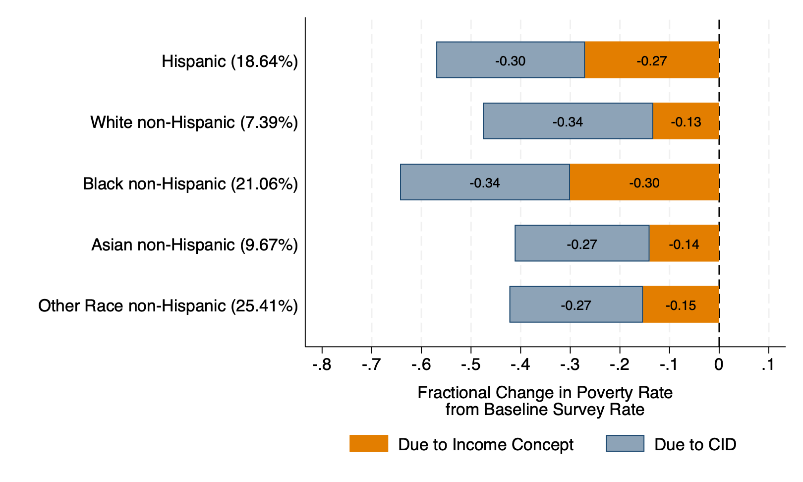
Implications of Differential Biases on Overall Changes in Poverty
Prior results tend to focus on biases in take-up for particular programs; but taken together these biases can have cumulative effects on poverty and other summary measures of the income distribution (Meyer and Wu 2023)
Source: 2017 CPS ASEC linked to various administrative records)
Approved for release by the Census Bureau’s Disclosure Review Board, authorization number CBDRB-FY2022-CES005-016
Notes:
Do after BM table on OASDI/pensions
Previous results focus on take-up; lots of other questions where these biases in take-up matter and have implications

Slide 35
Discussion and Conclusions

Slide 36
Summary
Did not set out to examine racial differences in misreporting, but rather race was one of 25 explanatory variables in JHR paper, 3 of 28 variables in New York paper, and 4 of 45 variables in unemployment insurance project
Racial differences in reporting are also secondary in the work on Social Security and private pension reporting
Race (and Hispanic ethnicity) are probably the most robust determinants of misreporting across these papers – repeatedly these variables have large and statistically significant effects
Each paper looks at multiple surveys (with exception of Bee and Mitchell), and in one case multiple programs
Three surveys: ACS, CPS, SIPP
Three samples: IL and MD, New York, National Data
Six income sources or programs: SNAP, Public Assistance (TANF + General Assistance combined), Unemployment Insurance, Social Security, private pensions, Medicaid
Suggests that the differential biases in reporting along race/ethnicity are not limited to a particular setting but are a general phenomenon
Notes:
** DW: filled in xx’s in first bullet
** Add Bee and Mitchell to this summary too
** External validity?
Future – linked data

Slide 37
Sources of Errors
We have very limited information on the source of errors
Combination of field representatives (interviewers) and respondent
Meyer et al. (2023) finds that salience, recall, heterogeneity in care of respondents/field representatives, stigma, and other factors matter
May not be that minority respondents are the source of the errors
Field representatives may hurry through interviews in minority areas
Does seems to be that minority responses are generally lower in accuracy as measured by both false negatives and positives
Notes:
Dimensions of accuracy are false negatives, false positives; we should look at errors in amounts, and imputation rates
** First lay out summary; then discuss at a broad level what are the sources of the discrepancies

Slide 38
Implications
Program receipt is higher for Blacks and Hispanics relative to whites and non-Hispanics than indicated by survey data
Implies that many papers have understated the relative receipt of these groups
Implications for disproportionate use literature
Implications for discrimination literature
Also suggests that poverty differences between minorities and others are likely overstated
Suggests one should be cautious in interpreting many survey based racial and ethnic differences
Further highlights the importance of linking survey and administrative data
On their own, each source has weaknesses
Survey data understate receipt, while administrative data often lack or have erroneous measures of race/ethnicity (as that information is not used to administer programs, etc.)
But linking together these records unlocks the ability to conduct accurate distributional analyses of programs along not only racial/ethnic lines but also other characteristics
Notes:
Survey data understates receipt
Admin data mismeasures race/ethnicity
new SSA data do not have race, IRS data definitely don’t have race
Admin records could be inaccurate; race is not needed to administer program
To continue to use survey data, need linked records

Slide 39
References (need to expand)
Bollinger, C.R. and David, M.H. 1997. “Modeling Discrete Choice with Response Error: Food Stamp Participation.” Journal of the American Statistical Association, 92 (439), 827-835.
Burkhauser, R.V., Corinth, K., Elwell, J. and Larrimore, J. 2022. “Evaluating the Success of President Johnson’s War on Poverty: Revisiting the Historical Record Using an Absolute Full-Income Poverty Measure.” NBER Working Paper 26532, Revised August 2022.
Celhay, Pablo, Bruce D. Meyer and Nikolas Mittag. 2021. “Errors in Reporting and Imputation of Government Benefits and Their Implications” NBER Working Paper 29184.
Forsythe, E., and Yang, H. 2021. “Understanding Disparities in Unemployment Insurance Recipiency,” Report to the Department of Labor.
Gould-Werth, A., and Shaefer, H.L. 2012. “Unemployment Insurance Participation by Education and by Race and Ethnicity.” Monthly Labor Review 135: 28.
Kuka, E., and Stuart, B.A. 2021 “Racial Inequality in Unemployment Insurance Receipt and Take-Up.” NBER Working Paper 29595.
Meyer, B.D. and Mittag, N. 2017. “Misclassification in Binary Choice Models.” Journal of Econometrics. 200(2), 295-311.
Meyer, B.D., Mittag, N. and Goerge, R. 2022. “Errors in Survey Reporting and Imputation and Their Effects on Estimates of Food Stamp Program Participation.” Journal of Human Resources 57(5): 1605-1644.
Meyer, Bruce D., Derek Wu, Matthew Stadnicki and Patrick Langetieg. 2023. “The Reporting of Unemployment Insurance and Unemployment in Survey and Administrative Sources.” Working Paper.
Mittag, N. 2019. “Correcting for Misreporting of Government Benefits.” American Economic Journal: Economic Policy 11(2): 142-16.
Moffitt, R.A. and Gottschalk, P.T., 2001. Ethnic and racial differences in welfare receipt in the United States. In America becoming: Racial trends and their consequences, Vol. 2, Chapter 7, pp.152-173. Washington, DC: The National Academies Press.
U.S. Census Bureau. 2022. “Poverty in the United States: 2021.” Current Population Report P60-277. U.S. Census Bureau.
U.S. General Accounting Office (GAO) 2022. “Pandemic Unemployment Assistance: Federal Program Supported Contingent Workers Amid Historic Demand, but DOL Should Examine Racial Disparities in Benefit Receipt” Report to Congressional Committee GAO-22-104438, Washington, D.C.

Slide 40
Appendix Slides

Slide 41
Determinants of False Negatives and Positives in IL and MD: Non-White vs. White
Notes:
Non-white relative to white (the paper reports reverse but for this paper we might want to just change the sign and describe as Non-white relative to white)
White rows from Table 3 and 4 in one small table
** DW: Multiplied “white” coefficients by negative one and re-labeled as “non-white”

Slide 42
Determinants of Reported and Admin SNAP Receipt in IL and MD: Non-White vs. White
Notes:
Non-white relative to white (the paper reports reverse but for this paper we might want to just change the sign and describe as Non-white relative to white)
**Report where survey and admin statistically different.
White rows from Table 5 a second small table?
** DW: Multiplied “white” coefficients by negative one and re-labeled as “non-white”

Slide 43
Determinants of False Negatives and Positives in NY: Black/Hispanic vs. White
Notes:
Table 4 and 5 combined in one table, Black and Hispanic rows, N?
** DW: Font may end up being too small if we were to include N, though let me know if you’d like to see it

Slide 44
False Positive and False Negative Misreporting Rates (%) by Demographic Group, CPS and SIPP
Notes:
Here we report error rates by demographic group in our two surveys. In the top panel by race and ethnicity, then by income, and finally by education.
We see that in the CPS false negative rates are substantially higher for Blacks than whites, 49 percent compared to 33 percent. In other words they are 50 percent highe, r for Blacks. Rates are even high for Hispanics over 51 percent.
Rates are 14-16 percentage points higher for those with survey income below the poverty line than other income groups. They are also 14 percentage points higher for the least educated compared to college grads.
The Black/white gap almost identical in SIPP, the Hispanic difference much smaller, and the other contrasts are largely absent
Note that false positive rates here are calculated as a share of all non-recipient ADULTS (over age 18). In slide 12 (the overall results), those are older numbers where they are calculated as a share of all non-recipient individuals (regardless of age) so they will be a little lower

Slide 45
Robustness Checks
Incorporating 1040s from processing year 2012 reveals that late filers have a very small effect on the results
Main results on misreporting of UI in surveys hold after excluding California and New Jersey from sample (which had paid family leave programs in 2010 that were included with UI on Box 1 of 1099-Gs)

Slide 46
Previously Disclosed Results
Comparing administrative data sources (namely 1099-Gs and 1040s), we estimate that UI dollars on 1040s are nearly a subset of those on 1099-Gs
However, 24% of true UI recipients according to 1099-Gs do not report their UI receipt on 1040s, with at least 30% of this group not filing any tax returns despite having taxable incomes above the filing threshold (simulated using linked CPS-IRS data)
After linking 1099-Gs (the more complete admin source of UI receipt) to CPS and SIPP microdata, we find that:
Aggregate UI dollars in both surveys are understated by 36-38%; vast majority of the understatement comes from 39% and 35% of UI recipients not reporting any receipt in the CPS and SIPP, respectively
In addition, we find that 49% of UI recipients never report being unemployed in the CPS, with 45% of this group reporting that they worked on a full-time basis for entire year

Slide 47
Newly Disclosed Results
Some robustness checks:
Incorporating 1040s from processing year 2012 reveals that late filers have a very small effect on the agreement between UI on 1040s and 1099-Gs
Main results on misreporting of UI in surveys hold after excluding California and New Jersey from sample (which had paid family leave programs in 2010 that were included with UI on Box 1 of 1099-Gs)

Slide 48
Newly Disclosed Results (cont.)
Extending survey misreporting analyses of UI to population subgroups in CPS and SIPP, we find that:
Survey-reported UI dollars are most understated among those who have lower levels of education, have lower levels of income, are black or Hispanic, and are elderly
Differences across subgroups in overall misreporting are driven primarily by differences in false negative rates (i.e., under-reporting at the extensive margin)
Gaps in false negative rates between subgroups (particularly by income and race/ethnicity) largely remain statistically significant after controlling for other covariates
Replacing survey UI values with admin values leads certain characteristics like black/Hispanic, low income, and lower levels of education to be relatively more positive determinants of benefit receipt
Pattern holds for multiple definitions of UI eligibility

Slide 49
Implications
The differential reporting of survey UI by education, race, ethnicity and income means that the disparities along these dimensions are likely overstated or even reversed
Notes:
DW: Deleted “and Extensions” from title slide

